Slide 1

Mini-Project [DBMS]
TITLE :
Data analysis for sales, delivery, and restaurants.
Submitted by :
Sneha Sanjeevkumar (project no :2)

Slide 2
Problem Definition
Databases:
Sales and Delivery
Restaurant
Problem Statement :
Retrieving data from sales and delivery domain of an organization based on the given scenarios.
Assessing performances of different restaurants based on different options and analyzing the data based on ratings.
Creating triggers for an institute to maintain the backup details of the alumni.

Slide 3
Data Set Description
Sales and Delivery:
This database comprises data from a business organization's sales and delivery domain that has been collected for a decade.
There are 5 tables in the database.
Table | Information in the table
cust_dimen | Customer name, Province, Region, Customer segment (types), Cust_id(customer ID)
market_fact | Ord_id(ID of the order), Prod_id(product ID), Ship_id(shipping ID), Cust_id, Sales, Discount, Order Quantity, Profit, Shipping_cost, Product_Base_Margin
orders_dimen | Order_id, Order_date, Order_priority, Ord_id
prod_dimen | Product_Category, Product_Sub_Category, Prod_id
shipping_dimen | Order_ID, Ship_Mode, Ship_Date, Ship_id

Slide 4
Restaurant database:
This database consists of data related to restaurants and users.
Table | Information in the table
chefmozaccepts | placeID, Rpayment
chefmozcuisine | placeID, Rcuisine
chefmozhours4 | placeID, hours, days
chefmozparking | placeID, parking_lot
geoplaces2 | placeID, latitude, longitude, the_geom_meter, name, address, city, state, country, fax, zip, alcohol, smoking_area, dress_code, accessibility, price, url, Rambience, franchise, area, other_services
rating_final | user_id, placeID, rating, food_rating, service_rating
usercuisine | user_id, Rcuisine
userpayment | user_id, Upayment
userprofile | user_id, latitude, longitude, smoker, drink_level, dress_preference, ambience, transport, marital_status, hijos, birth_year, interest, personality, religion, activity, color, weight, budget, height

Slide 5
Business Importance of Problem
Sales and delivery datasets:
Tracks sales performances.
Improve sales performances.
Helps in organizational decision making.
Identifying target customers becomes easier.
Helps to bring in more customers.

Slide 6
Business Importance of Problem
Restaurant datasets:
Useful in enhancing customer experience.
Helps in improving the business based on the rating results and new trends.
Useful in attracting more customers.
Helps identifying customer preferences.
Identifies the most sold food.
Useful in improving the cuisine.

Slide 7
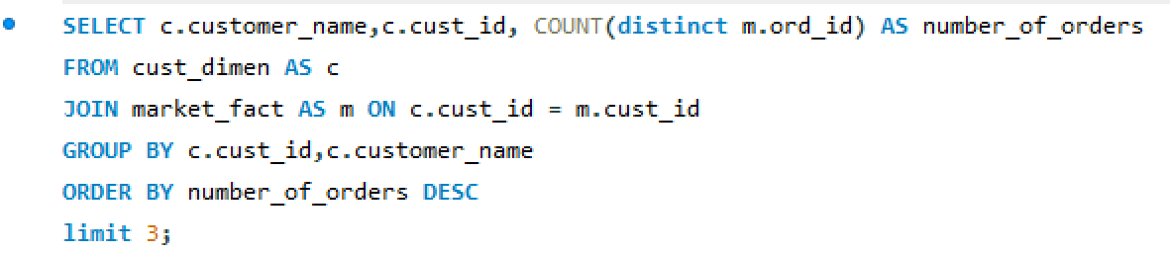
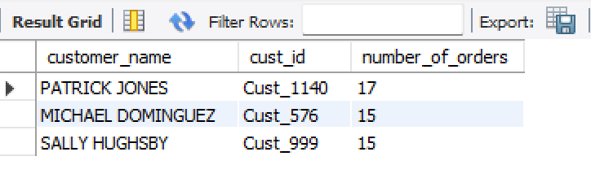
Project Flow – Question 1
Q:Find the top 3 customers who have the maximum number of orders
First we need to know the top customers with maximum number of orders then extract top 3.

Slide 8
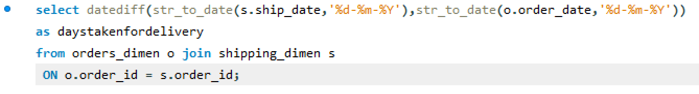
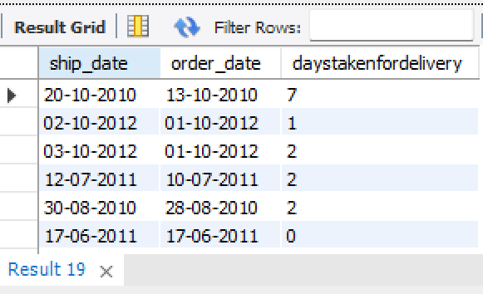
Project Flow – Question 2
Q: Create a new column DaysTakenForDelivery that contains the date difference between Order_Date and Ship_Date.
Create a new column ‘DaysTakenForDelivery’ which specifies the date difference between the ‘Order_Date’ and the ’Ship_Date’.

Slide 9
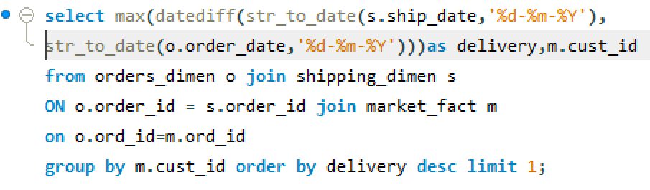
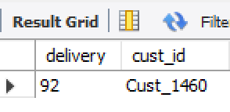
Project Flow – Question 3
Q: Find the customer whose order took the maximum time to get delivered.
Find the customer whose date difference between order date and ship date is maximum.

Slide 10
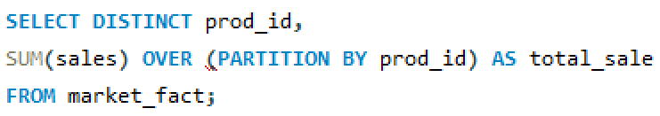
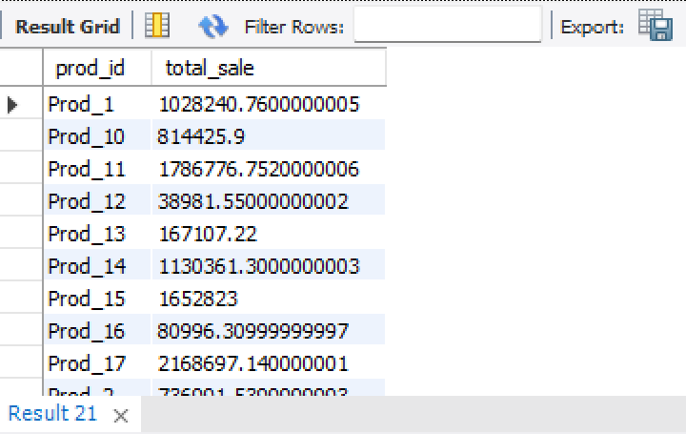
Project Flow – Question 4
Q:Retrieve total sales made by each product from the data (use Windows function)
Retrieve the sum of total_sales and distinct each product (using the Windows function).

Slide 11
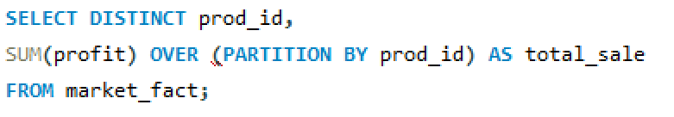
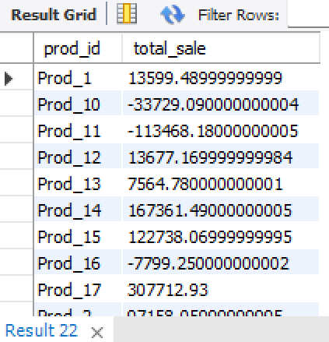
Project Flow – Question 5
Q:Retrieve the total profit made from each product from the data (use windows function)
Using the data, calculate the sum of profit made from each product (using the Windows function).

Slide 12
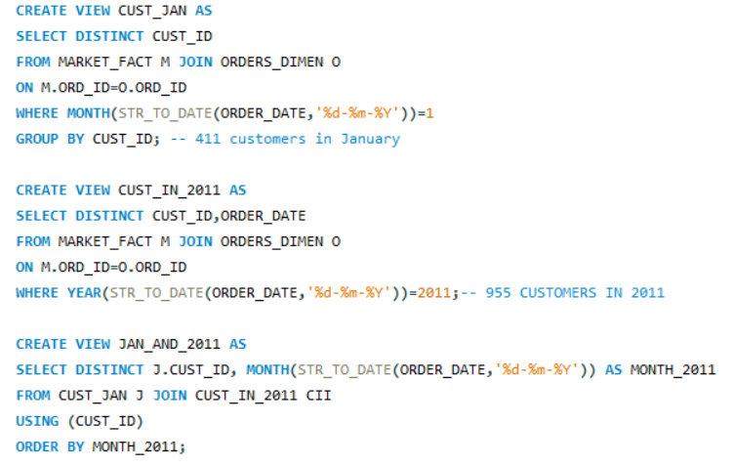
Project Flow – Question 6
Q:Count the total number of unique customers in January and how many of them came back every month over the entire year in 2011

Slide 13
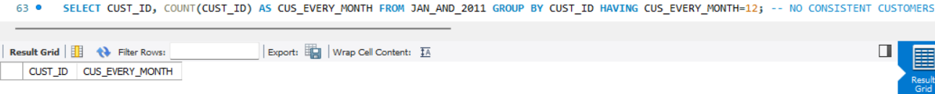
Project Flow – Question 6
2 views have been created for retrieving customers in January of every year (CUST_JAN) and customers of 2011 (CUST_IN_2011). A third view (JAN_AND_2011) was created from the previous views to obtain the common customer IDs along with the purchase months in 2011. For each month, the customer ID will be present only once. To get the customers who have purchased in all the months of 2011, individual customer IDs are counted and the count should be equal to 12.
Inference: None of the customer have made purchases in all the months of 2011

Slide 14
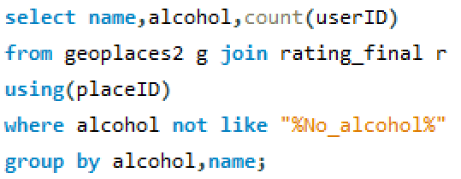
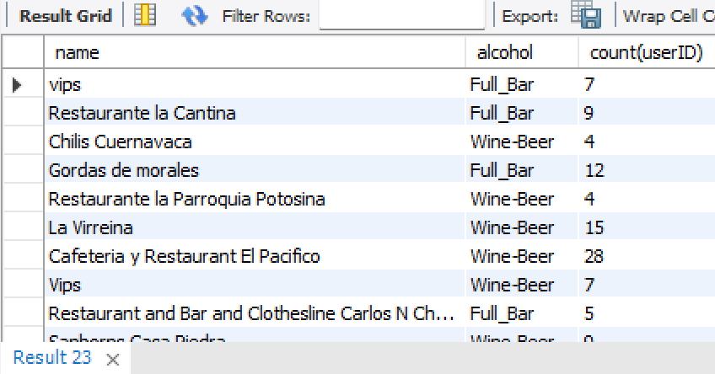
Project Flow – Question 1
Q:We need to find out the total visits to all restaurants under all alcohol categories available.
We need to know the overall number of visits to all restaurants across all alcohol categories.

Slide 15
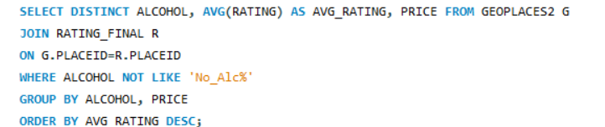
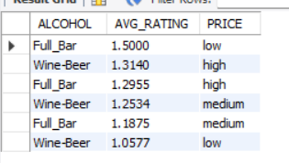
Project Flow – Question 2
Q:-Let's find out the average rating according to alcohol and price so that we can understand the rating in respective price categories as well.
Let's calculate the average rating based on alcohol and price so that we can comprehend the rating in different pricing ranges.

Slide 16

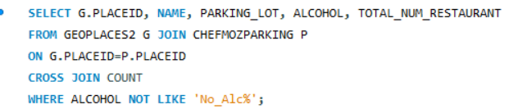
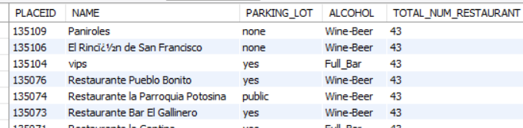
Project Flow – Question 3
Q:Let’s write a query to quantify that what are the parking availability as well in different alcohol categories along with the total number of restaurants.
Let's create a query to determine the availability of parking in various alcohol categories, as well as the overall number of restaurants.

Slide 17
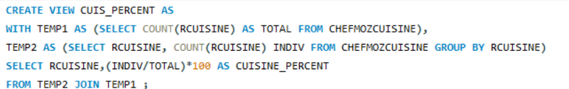
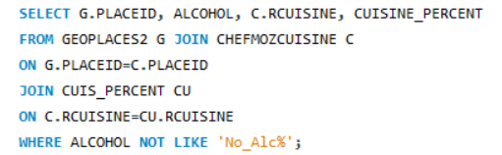
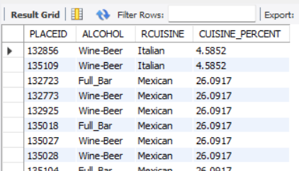
Project Flow – Question 4
Q:Also take out the percentage of different cuisine in each alcohol type.
-Additionally, calculate the percentage of different cuisines in each alcohol type.

Slide 18
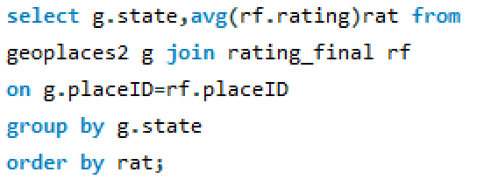
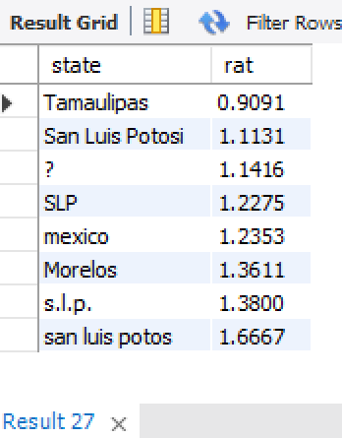
Project Flow – Question 5
Q:let’s take out the average rating of each state.
Take the average rating for each state.

Slide 19
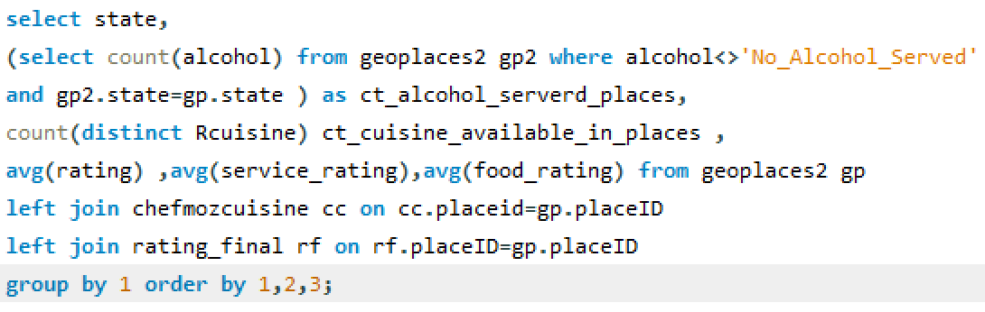
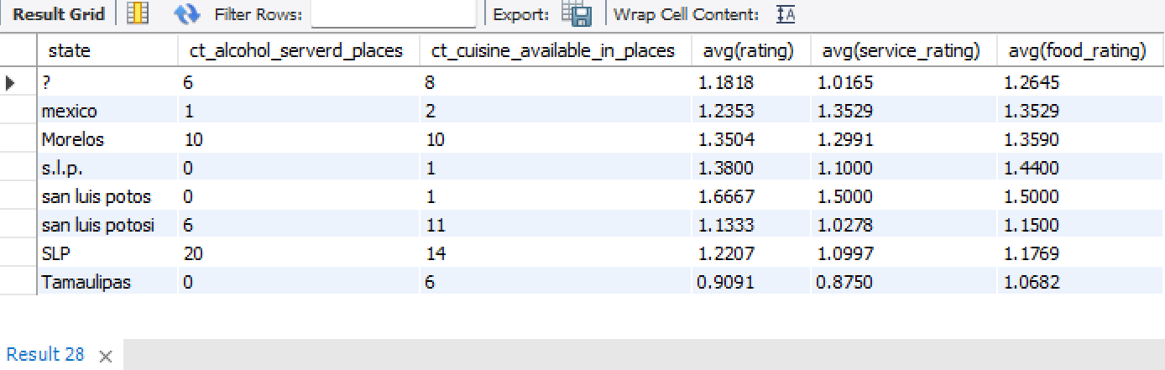
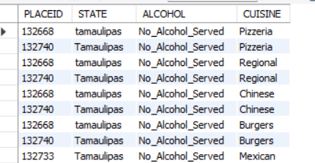
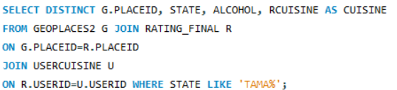
Project Flow – Question 6
Q:' Tamaulipas' Is the lowest average rated state. Quantify the reason why it is the lowest rated by providing the summary on the basis of State, alcohol, and Cuisine.
Though Tamaulipa serves a variety of cuisines, Tamaulipa restaurants never served alcohol

Slide 20
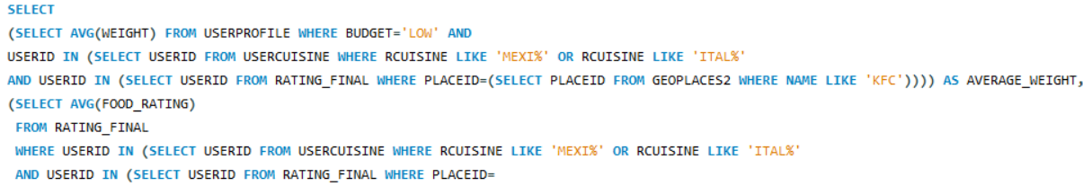
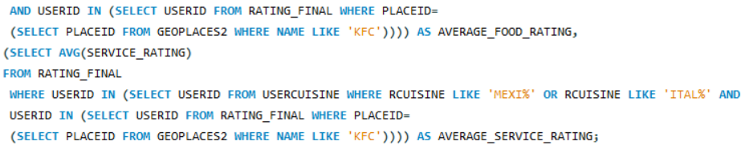
Project Flow – Question 7
Q:Find the average weight, food rating, and service rating of the customers who have visited KFC and tried Mexican or Italian types of cuisine, and also their budget level is low. We encourage you to give it a try by not using joins. – All the conditions where applied to all the required attributes.

Slide 21
TRIGGER
Trigger is a statement that a system executes automatically when there is any modification to the database. In a trigger, we first specify when the trigger is to be executed and then the action to be performed when the trigger executes. Triggers are used to specify certain integrity constraints and referential constraints that cannot be specified using the constraint mechanism of SQL.

Slide 22
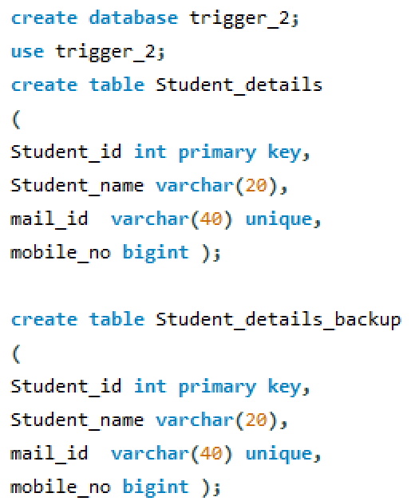
Trigger – Question 1
Q:Create two called Student_details and Student_details_backup.

Slide 23
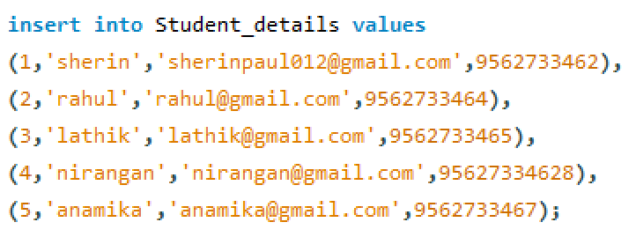
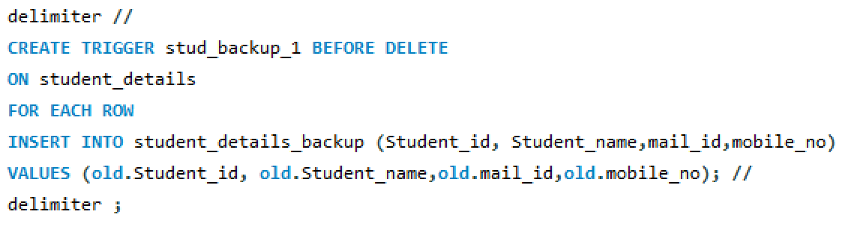
Trigger – Question 1

Slide 24
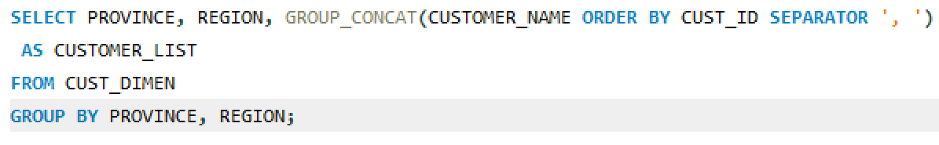
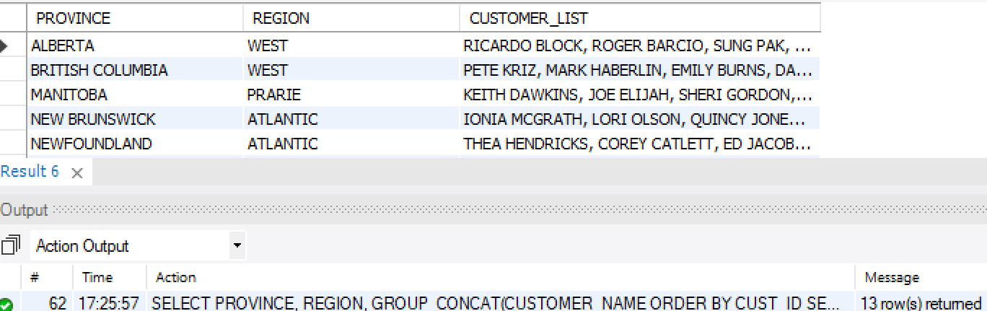
Major Challenge
Q1: Use of GROUP_CONCAT function to show customers from same city.
GROUP_CONCAT() here is useful displaying all the customers from the same location in a single row.

Slide 25
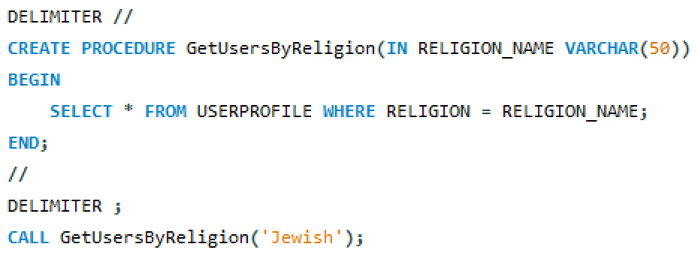
Major Challenge
Q2: Creating stored procedure to retrieve user ids based on religion. The stored procedure will be useful to make attractive offers during festival times.
Creating a stored procedure is useful in applying a set of code whenever required, just by calling the stored procedure’s name along with the wanted record name.

Slide 26
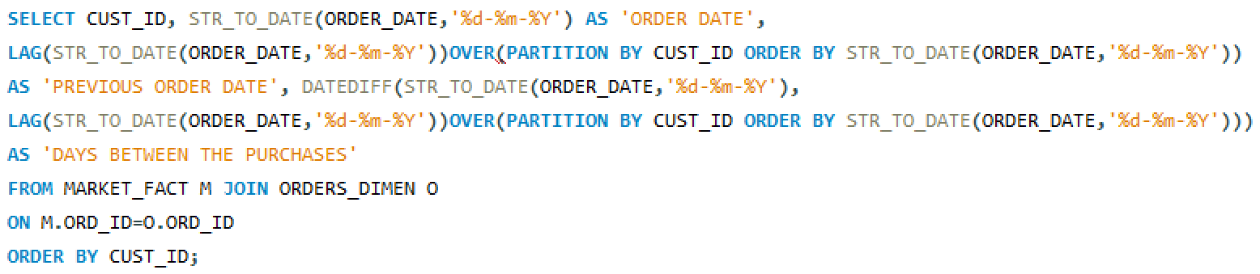
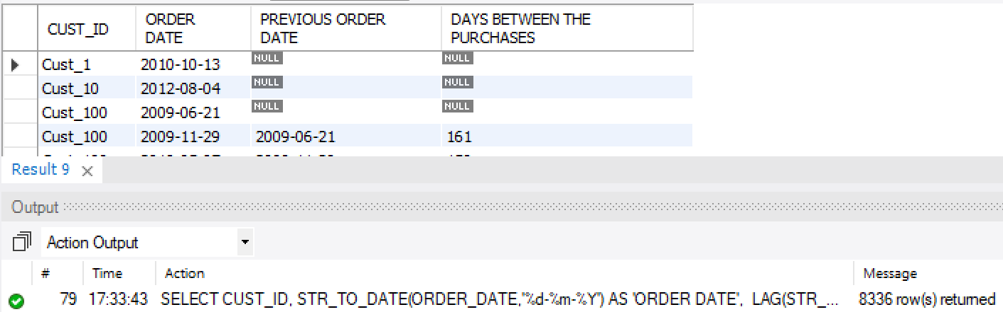
Major Challenge
Q3:Calculate delta values of order date for each customer
The purpose of getting delta values between the order dates for each customer is to get the number days between the previous and current purchases.

Slide 27
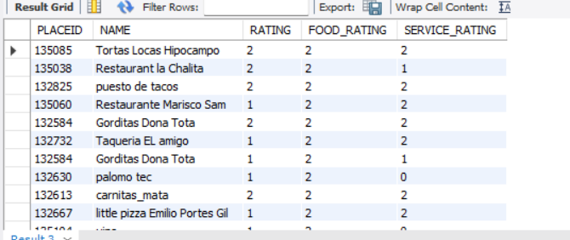
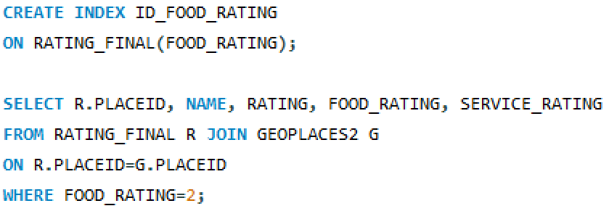
Major Challenge
Q4:Creating index on food_rating to retrieve restaurant information easily.
Assigning indexes on food rating, allows the users to quickly sift through a list of restaurants based on the food rating. Here 2 is the highest rating.

Slide 28
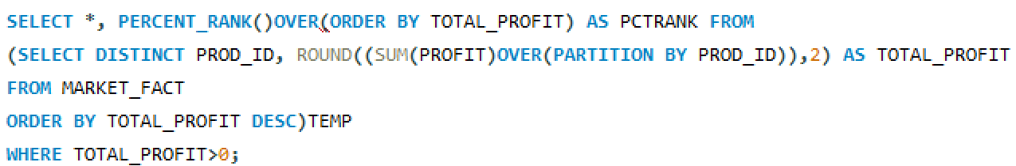
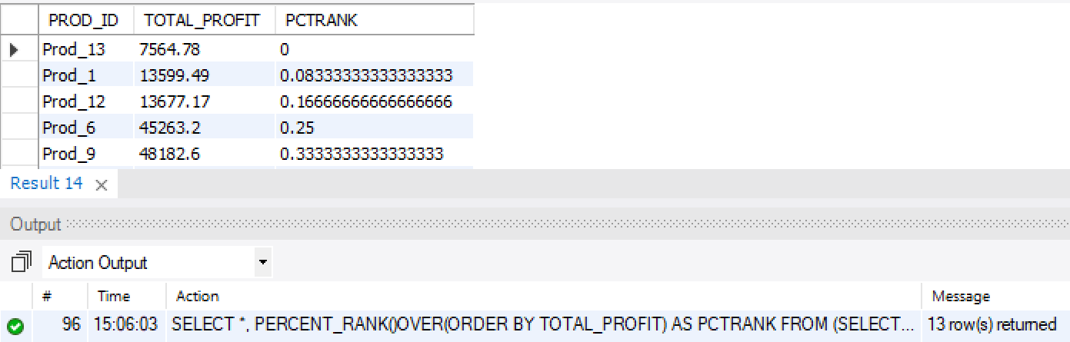
Major Challenge
Q5:Retrieve the total profit made from each product from the data and give percentile ranks where total profit is positive.
The products are given percentile ranks between 0 to 1 where the total profit is positive. 0 is given for the lowest total profit and 1 for the highest total profit.

Slide 29
Conclusions
We got to learn and use triggers, stored procedures, and indexes in MySQL.
From the datasets of sales and delivery and restaurant, we were able analyze the performances, retrieve data based on certain conditions, analyze customer choices based on profits and ratings, and find the factors that affect the growth of sales in an organization and performances of restaurants.

Slide 30
Thank You !!!....

